Slide 1

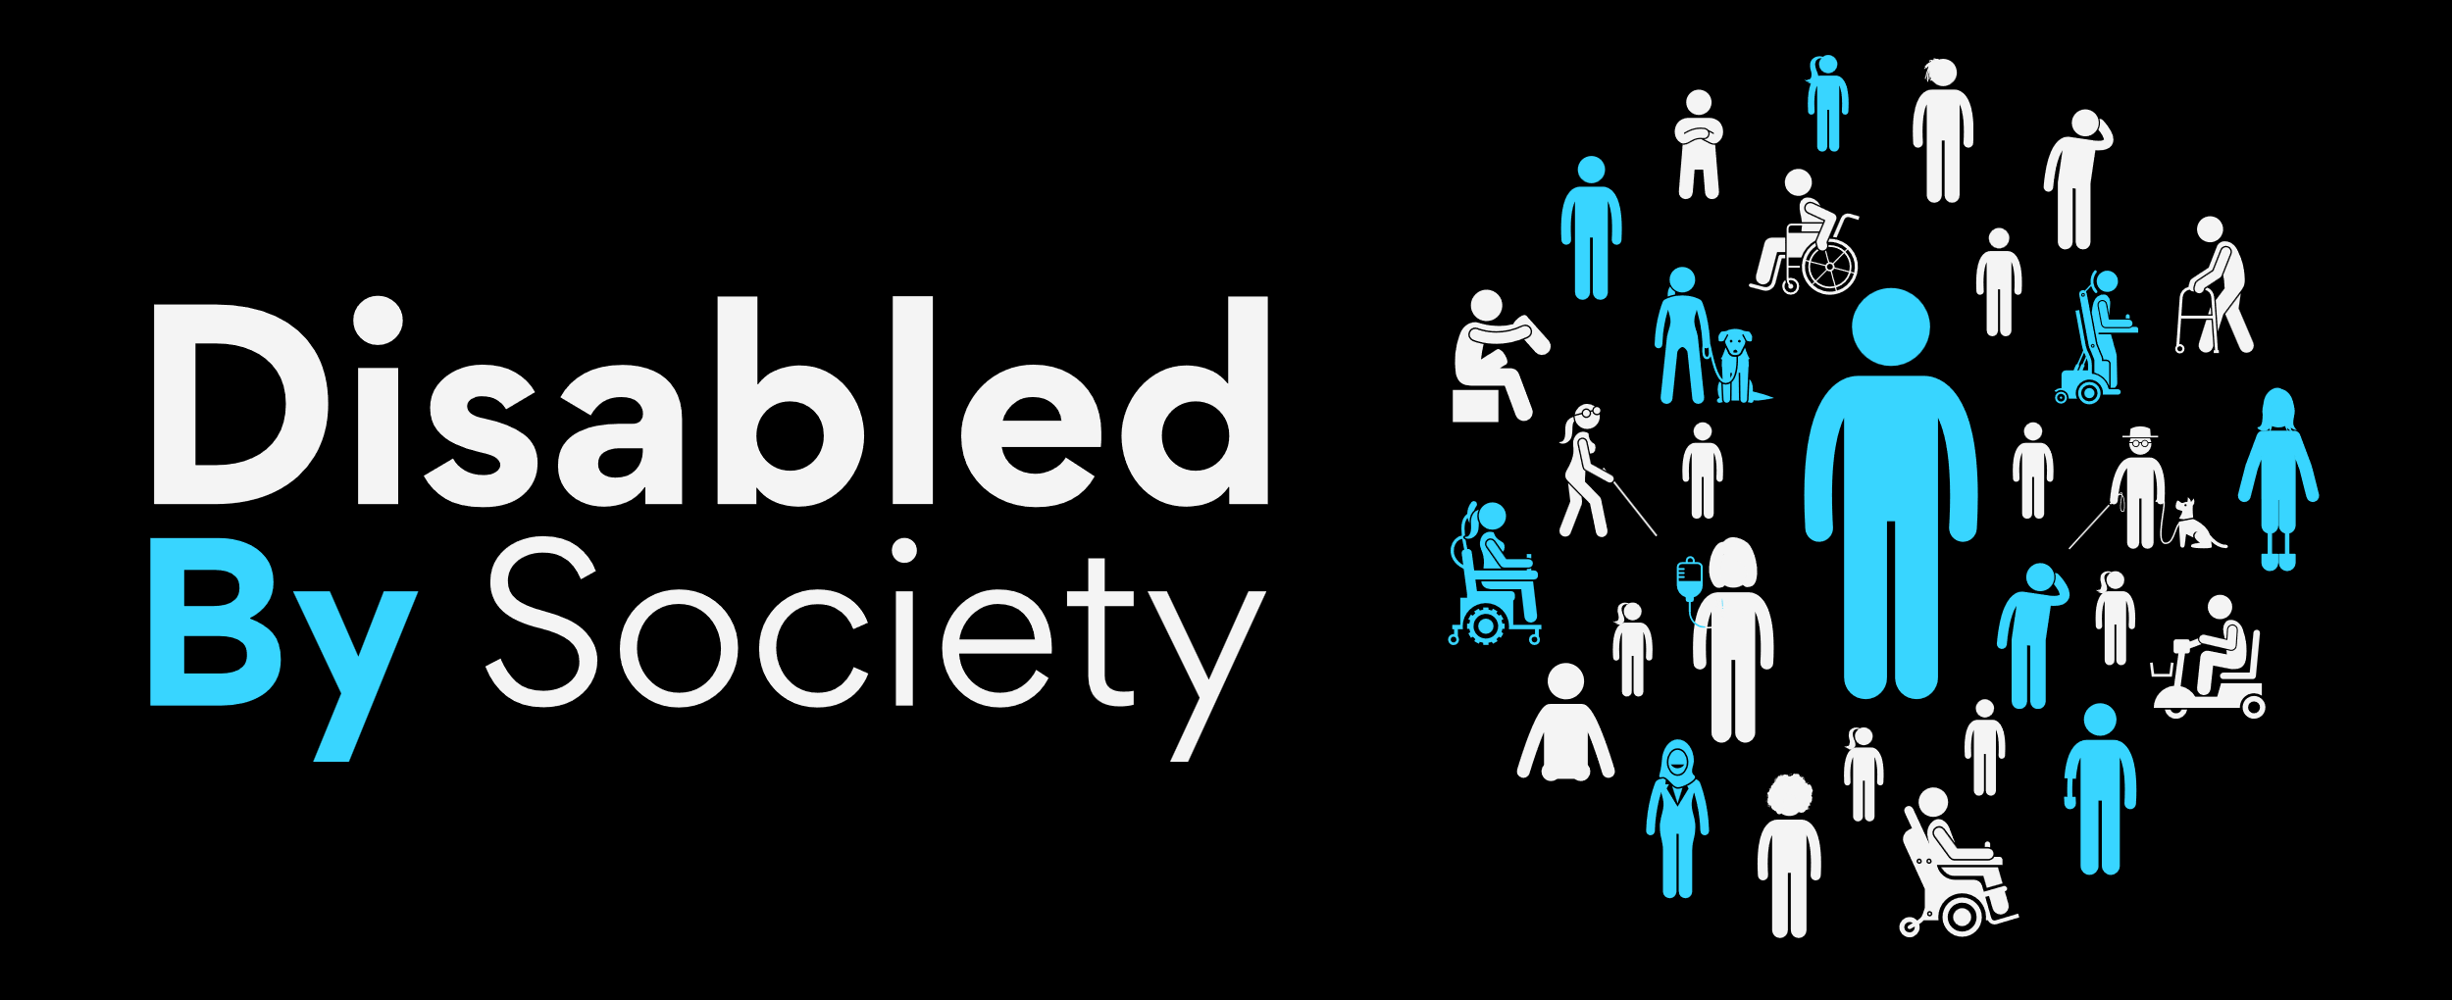




















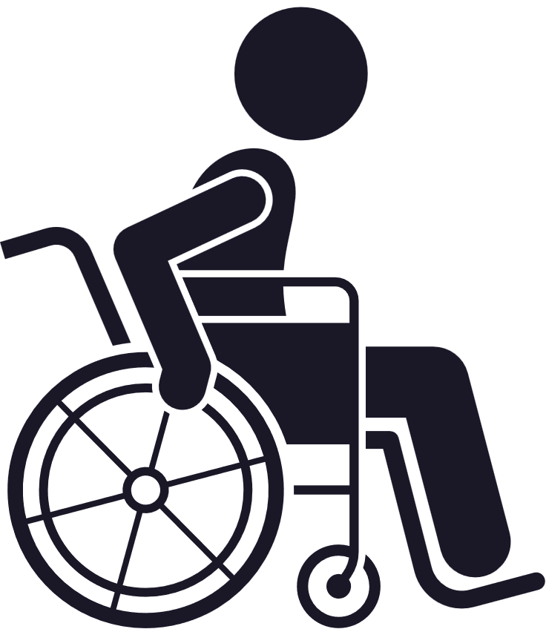

Internalised Ableism Policy Paper
Data & Results
From Disabled By Society - Disability Pride 2025

Slide 2

Contents
  Front Cover
  Contents
  Who Are We?
  Introductory Remarks
  Executive Summary
  Key Findings
  Recommendations
  Data Analysis Introduction
  Internalised Ableism:
Equity of Access
Mental Health
Sectoral Systems
Medical Lens - Equitable Care
Simultaneous Oppression
Representation and Awareness
Foundational Support
  Thank You
  Contact Holding Cover
  Appendices:
Working Methodology
Accountability and Responsibility
Opportunity and Outcome
The Burden of Responsibility
Terminology
The Social Model of Disability
The Internalised Ableism Survey
  Closing Cover

Slide 3

Who Are We?
Community Led
100% Disability led, aligned purpose, goals, aspirations and a united voice driven by advocacy and desire for elevated change.
For Disabled people by Disabled people.
Recognised & Respected
Globally recognised and respected Disability organisation, connected and collaborative for impact elevation.
Passionate & Creative
Diversity of community led thought with aspirations for greater tangible impact and collaboration through creative changes.
Equity & Lived Experience
Led by the principles of intersectionality, equity and value of lived experience, making the uncomfortable comfortable.

Slide 4


100% Disabled owned and 100% Disabled led
What we do...
From consulting and training to audits and speaking, we deliver flexible, scalable solutions that help our clients transform exclusion to inclusion.
We design tailored solutions to help organisations break down disabling barriers, or call them what they are: ableist barriers. Most people shy away from the word ableism. But not us.
We’ve spent our lives disabled by society, and we don’t avoid the uncomfortable conversations. Instead, we make the uncomfortable comfortable, helping organisations recognise, address, and remove the barriers that exclude Disabled people.

Slide 5


Meet the Founders
Jamie Shields
Multi-award winning Disability, Speaker, Trainer & Consultant, Content Creator & Disability Advocate. Registered Blind AuDHD Rhino.
UK’s most influential Disabled person
Celia Chartres- Aris
Disabled Government Advisor, Founder & Investor, Multi-Award Winning Campaigner & Lobbyist, Researcher, Policy & Legal Expert, Speaker & Consultant
UK’s 2nd most influential grassroots Disability advocate

Slide 6
Isn’t it time we started Unlearning Internalised Ableism?
“
”
The truth, the whole truth, and nothing but the truth.

Slide 7
Executive Summary
Last year our ground-breaking Unlearning Ableism policy paper, capturing data in ‘The Big Ableism Survey’ painted a clear, stark and shocking picture of the palpable disparities between Disabled people and non-Disabled people in 2024. It painted a picture of how Disabled people truly feel about being Disabled in today’s society. Despite being the largest minority group in the world of over 17% of the global population, over 1.3 billion Disabled people are consistently being left behind, with barriers inhibiting inclusion, equity, opportunities, participation, representation and the breaking of barriers.
We concluded that around every corner Disabled people face multiple barriers to participation and opportunity such as attitudinal, perceptions, stereotypes. The barriers faced by Disabled people, are consistently at every single component of life such as work, education, community, social and technological. We also highlighted how Ableism is having a devastating consequence on the mental health and internalised Ableism of Disabled people. We discovered that only 6.6% Of Disabled people have never experienced mental health challenges as a direct result of their Disability, and only 1.5% of Disabled people have never experienced Internalised Ableism.
And that leads us to today. A targeted focus on internalised ableism amongst Disabled people.

Slide 8
Executive Summary continued
The responses we received from survey respondents were emotional, thought-provoking, and woven with sadness and frustration. Through this paper we have investigated the pervasive impact of internalised ableism on Disabled people, revealing it as a daily, often invisible battle that undermines mental health, self-worth, and social participation. Rooted in systemic discrimination and reinforced by societal attitudes, internalised ableism leads many Disabled people to adopt limiting beliefs about their own value and capabilities, have their mental health impacted, feel unsafe, isolated and lonely.
The research underscores that without targeted interventions, such internalised oppression perpetuates exclusion and reinforces existing inequalities. To address this, the paper recommends a multi-level policy approach including: inclusive education, training across all sectors, greater representation, and increased investment. These measures aim not only to dismantle internalised ableism but also to foster environments where Disabled people can thrive with dignity and autonomy.
We must all be forward thinking, proactive not reactive, and from the point of design with the correct and effective consultation of Disabled people move towards a better future for society that is accessible, equitable and inclusive of all Disabled people. A lack of support, education, awareness, proactiveness and a lack of proactiveness, a lack of wider societal allyship, are all contributing to Disabled people battling internalised ableism.
We must break the cycle of internalised ableism. It is evident from the realities unearthed by this research that the recommendations and commitments of Disabled By Society, is non-negotiable and must be observed in a manner of necessity.

Slide 9

Key Findings
73.5%
88.9%
94.6%
95.6%
of Disabled people said they didn’t learn about internalised ableism until at least a year after their diagnosis.
were introduced to the concept by other Disabled people, only 11% learned about it from medical professionals.
believe educational institutions are not doing enough to address or educate about internalised ableism.
believe workplaces are failing to educate or address internalised ableism.
94.6%
96.2%
22.3%
97%
believe medical and healthcare providers are not doing enough to tackle internalised ableism.
say early access to information and support is key to addressing internalised ableism.
said they had not experienced other forms of internalised oppression alongside internalised ableism.
believe there is a lack of awareness of internalised ableism across wider society.

Slide 10
Key Findings
92.7%
75.5%
81.3%
74.3%
believe there is not enough access to accessible, professional support for dealing with internalised ableism.
have not received any professional support, even though 98.5% report experiencing internalised ableism.
say internalised ableism has directly contributed to them developing a mental health condition.
feel shame about themselves, their identity, and their Disability because of internalised ableism.
79.7%
87.3%
85.4%
64.4%
report feeling isolated and lonely as a direct result of ableism and internalised ableism.
experience anger and frustration, directed at themselves or others, because of internalised ableism.
feel they have low self-worth as a result of internalised ableism.
feel unable to advocate for themselves due to the impact of internalised ableism on their confidence and self-belief.

Slide 11
Recommendations
Implementation of early-intervention mechanisms through affirming-practices across all sectors.
Restructured mental health pathways, with active, specialised mechanisms of support delivery and intervention.
Proactive shift of The Burden of Responsibility from individuals to institutions and focus on the privilege of information gap.
The recommendations of this paper are based on data capture and analysis providing actionable, evidence-based recommendations that address internalised ableism and improve the outcomes identified through the data.
These recommendations are designed for policymakers, stakeholders, or organisations.
They are rooted in data, tied to patterns, gaps, or trends uncovered in the analysis.
They are clear and actionable, realistic and targeted.
Widespread structural reform through education, with proactive policy and strategy development dismantling intrinsic prejudice.
Improved transparency to diagnosis and support through integrated care models and Social Model orientation.
Establishment of effective, community-led, intersectional and representative consultation and governance frameworks.
Review and subsequent amendment of foundational support frameworks to close service and support gaps.
Targeted cross-sector, hierarchy and institutions, education and awareness building mechanisms.

Slide 12
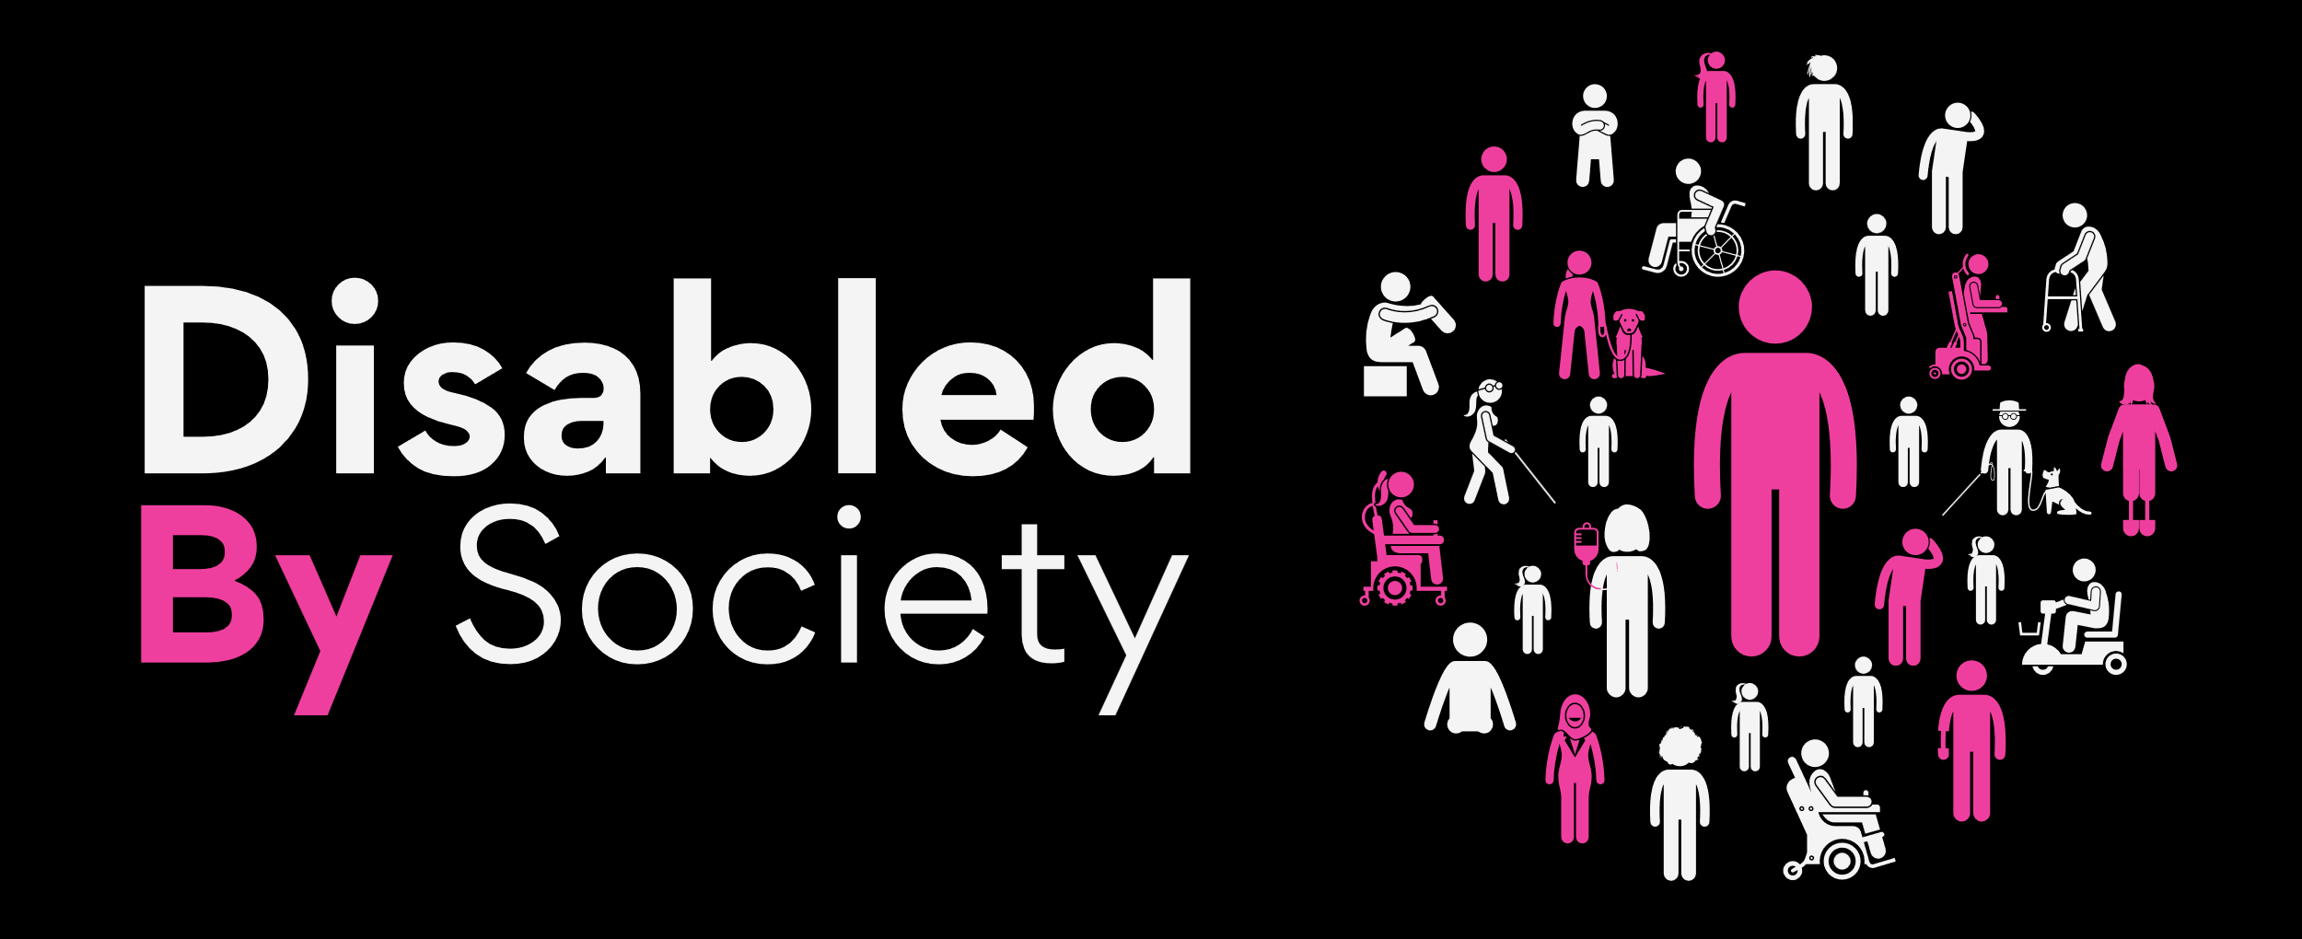


The Results Are In: Taking a Closer Look at the Data
Examining the qualitative and quantitive internalised ableism findings from data capture, offering insights to inform evidence-based decision-making.

Slide 13
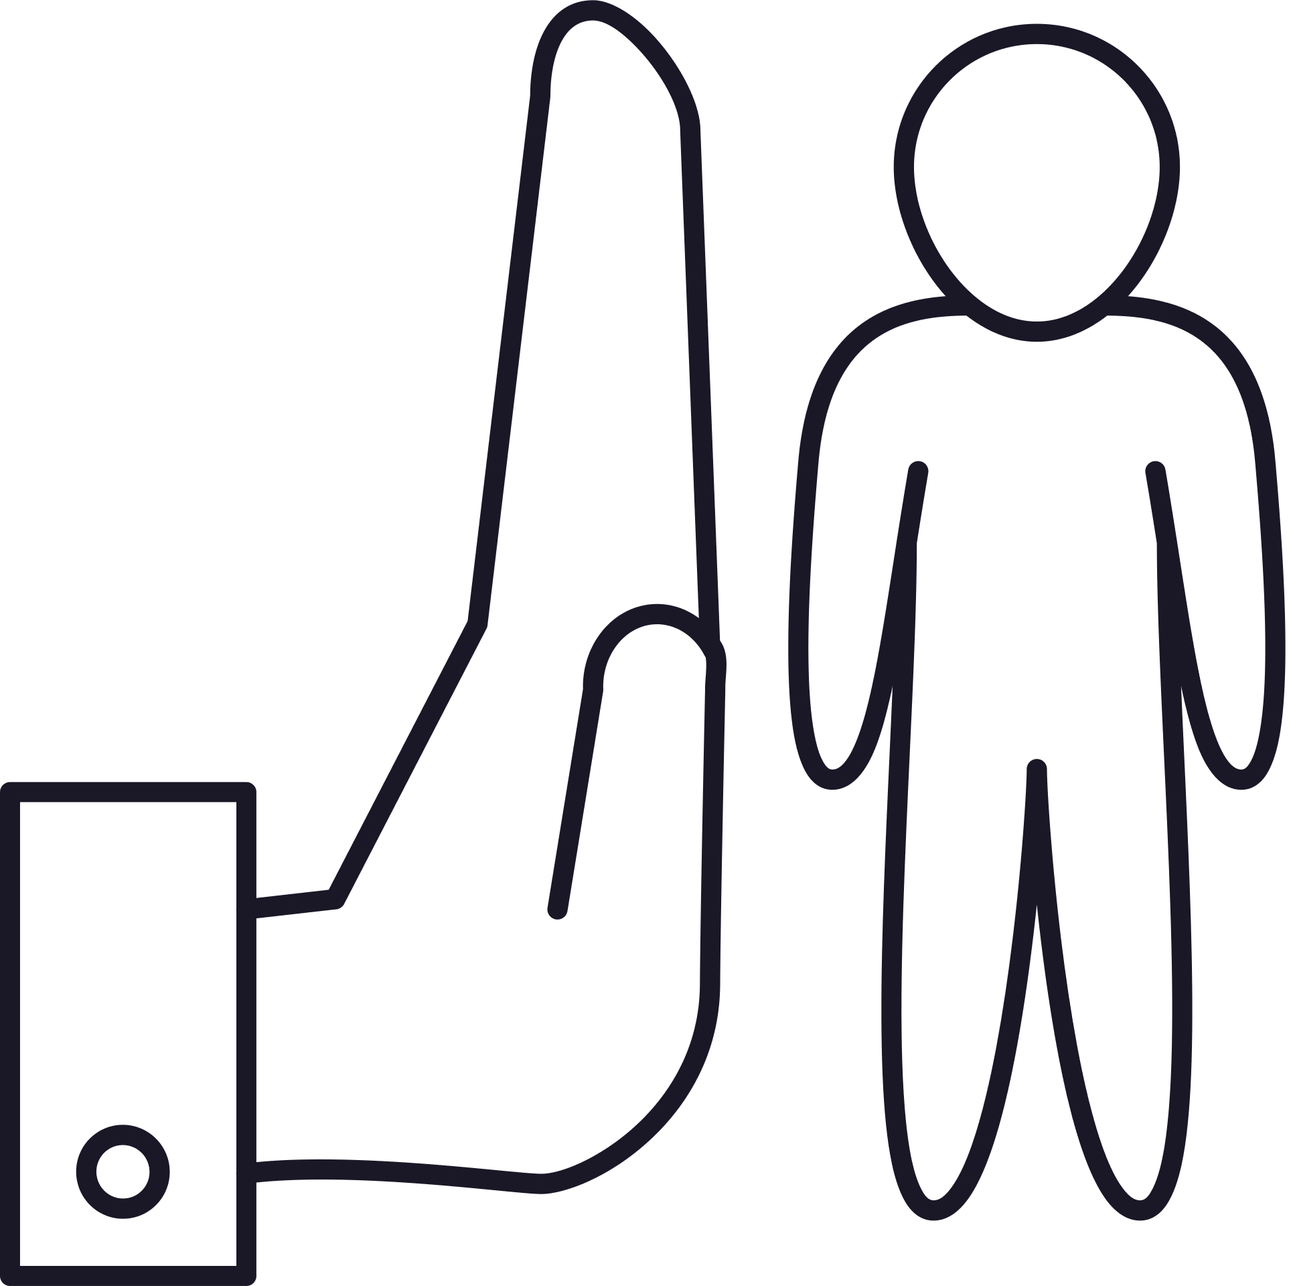

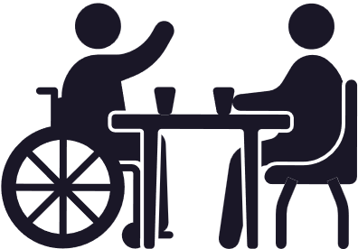

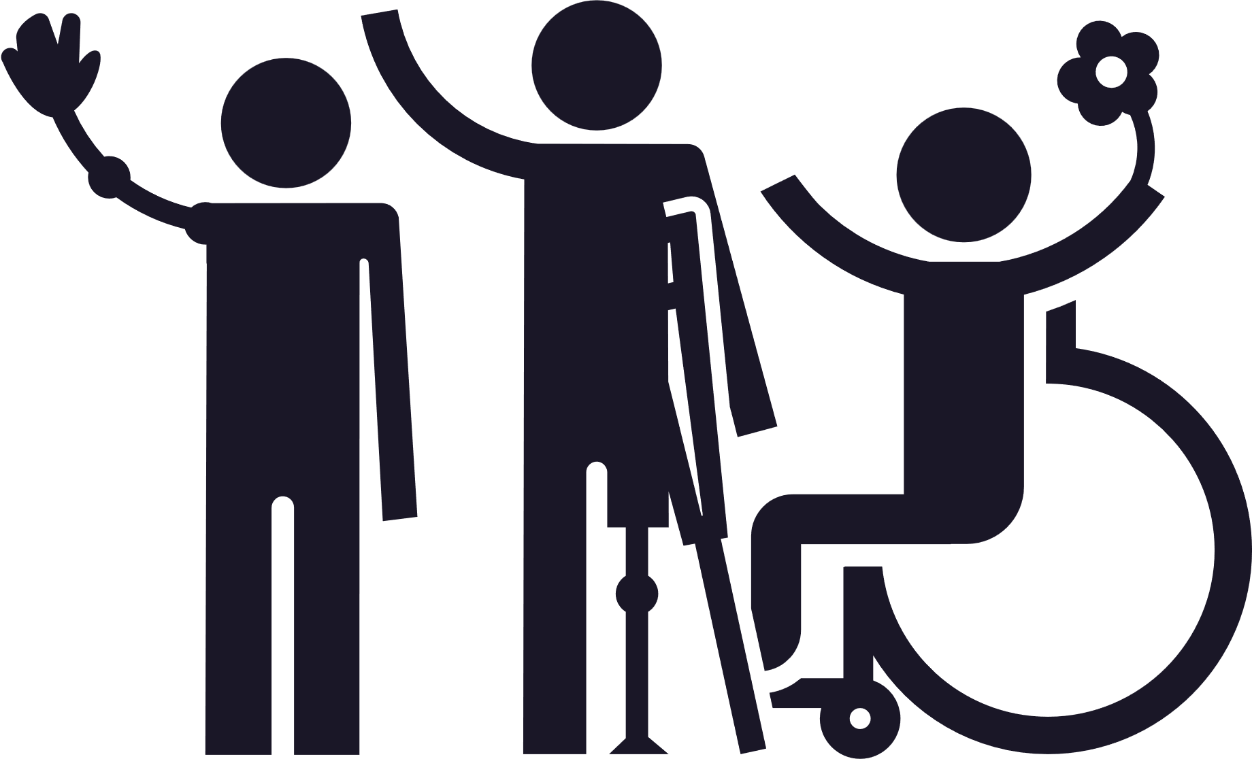
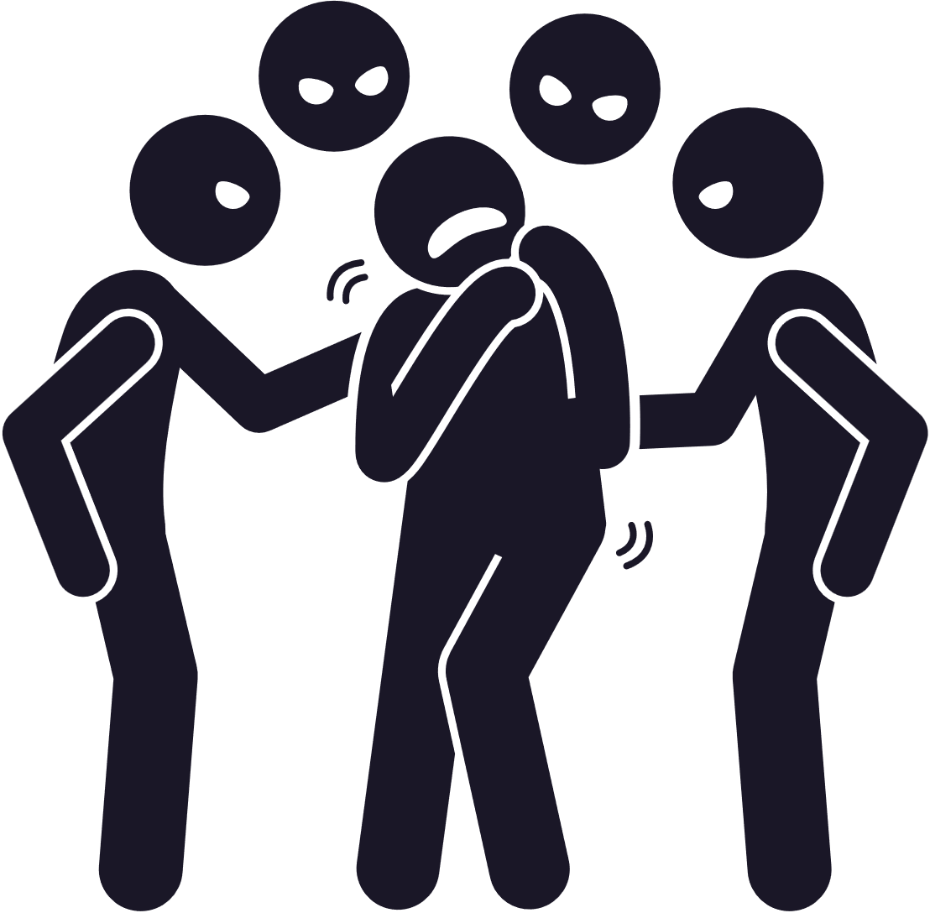



Internalised Ableism
Causation Factors
Internalised Ableism is when a Disabled person devalues or discriminates against themself and/or other Disabled people as a result of navigating an ableist, disabling society.
Disability doesn’t create internalised ableism, it is a direct consequence of society’s attitudes and structures, but living with a Disability in a world that devalues identity fosters internalised ableism, holding the view that Disability is something to be ashamed of, something to hide, refusing accessibility or support, or having a devastating impact on a person’s mental health.
Internalised Ableism manifests itself in a multitude of ways, and the experience is unique to an individual, happening as a consequence of a Disabled person absorbing the ableism they have experienced in society.
From our data capture in 2024, we ascertained that 50.3% of Disabled people experience internalised ableism every week, and only 1.5% of Disabled people have never experienced internalised ableism.
Negative Stereotypes
Isolation
Lack of Representation
Societal Structures
Social Comparison
Discrimination
Accessibility & Inequity
Opportunity & Participation
Broken Systems

Slide 14



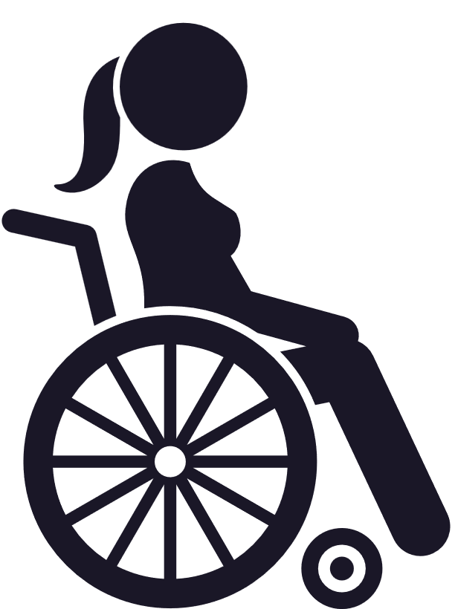



Equity of Access
73.5% of Disabled people didn't know about internalised ableism until at least over a year after their diagnosis
Equity of access to information on internalised ableism is a critical component of well-being and mental health, to break down the symptoms of internalised ableism experienced by the Disabled community.
Access to timely, accurate information about internalised ableism should not be a privilege, it is a necessity. For Disabled people navigating a society that consistently marginalises their existence, the concept of internalised ableism often goes undiscussed until its impact has already been deeply felt. Internalised ableism, the process by which Disabled people absorb society’s prejudices and stigma about disability, corrodes self-worth, distorts identity, and impacts mental health. And yet, most Disabled people are not introduced to this concept by healthcare systems or the services meant to support them.
According to our data, 73.5% of Disabled people did not learn about internalised ableism until over a year after their diagnosis (or a significant delay after the age of ability to understand). This delay represents more than just a gap in information; it signifies a profound failure in our systems of care. During this critical period, when Disabled individuals are adjusting to changes in identity, lifestyle, and social perception, they are often left to interpret their experiences through an ableist lens. The result is often shame, isolation, and self-blame. Internalised ableism becomes the weight that compounds the external barriers imposed by a disabling society.
96.2% of our respondents believe early intervention to access information and support is key to tackling internalised ableism. This overwhelming consensus cannot be ignored. Early education on internalised ableism equips individuals with the language to articulate their experiences, the confidence to reject internalised stigma, and the tools to manage its effects. It offers a vital lifeline, enabling people to navigate society not with self-doubt, but with self-awareness and empowerment.
88.9% of our respondents reported learning about internalised ableism from other Disabled people, while only 11% learned from medical professionals. This statistic highlights a systemic failure within the institutions most trusted to provide holistic care. It also places an unjust and unsustainable burden on Disabled communities themselves, already marginalised and under-resourced, to fill the gaps left by medical and educational systems. Peer support is powerful, but it should not be a substitute for institutional responsibility.
The consequences of this educational vacuum are dire. Without early understanding of internalised ableism, Disabled people are more vulnerable to depression, anxiety, self-harm, and social withdrawal. Our data shows Disabled people are less likely to advocate for their needs, challenge discriminatory practices, or access support systems effectively. This is not just a mental health issue, it is a social justice emergency. We must urgently shift the burden of responsibility away from Disabled individuals having to educate each other. Institutions, particularly healthcare providers, schools, and policy frameworks, must be proactive in integrating education on internalised ableism into early diagnosis pathways, therapeutic practices, and social services. This should already be a foundational policy for equitable care. Failure to do is, is a failure to Disabled people, to be complicit in perpetuating ableism. Information is not empowerment unless it is accessible.
Early intervention is not a theory; it is a necessity. Internalised ableism is not invisible, unless we choose to keep it that way.
88.9% of Disabled people are taught about internalised ableism by other Disabled people, compared to only 11% by medical professionals
96.2% believe early intervention to access information and support is key to tackling internalised ableism

Slide 15
Mental Health
81.3%
Have a mental health condition as a consequence of internalised ableism
Internalised ableism as a byproduct of the ableist discrimination faced in every aspect of society by Disabled people is a critical and often overlooked driver of the mental health crisis in the Disabled community. Overlooked by medical professionals, workplaces and the educational system. Internalised ableism embeds itself in the psyche of Disabled people, leading to individuals questioning their worth, identity and value, creating anger, frustration, loneliness, anxiety, depression, addiction and harmful thoughts.
Our data paints a stark and deeply troubling picture. An overwhelming 81.3% of Disabled people report developing a mental health condition as a direct consequence of internalised ableism. This is not incidental, it is a direct correlation between structural oppression and psychological harm. The very systems that should protect wellbeing are complicit in its erosion.
Internalised ableism breeds shame. 74.3% of respondents report feeling shame about themselves, their identity, and their Disability, revealing how societal narratives of "normality" and "productiveness" corrode self-acceptance. This shame is not innate; it is learned from years of exclusion, pity, infantilisation, and the relentless cultural messaging that to be Disabled is to be "less able."
79.7%
Feel isolated and lonely.
87.3%
Feel anger and frustration.
85.4%
Feel low self-worth.
74.3%
Feel identity shame.
The emotional toll is compounded by isolation and loneliness, experienced by 79.7% of Disabled people as a direct result of both external and internalised ableism. As well as being societally operated, Disabled people feel emotionally exiled, made to feel invisible, burdensome, or unworthy of connection. Anger and frustration as a response to injustice and self-worth are experienced by 87.3%. Rather than being acknowledged as responses to systemic harm, these feelings are often patholigsed, leaving Disabled people unsupported and mischaracterised.
85.4% also reported experiencing low self-worth as a consequence of internalised ableism. This is not a failure of the individual; it is a failure of society. When a person internalises the belief that they are inherently inferior, unlovable, or broken, the psychological impact created lasts a lifetime.
This data exposes an urgent truth: internalised ableism is not an abstract concept. It is a real and present danger to the mental health of Disabled people. It is costing self-esteem, severing connections, opportunity and participation, and fueling unspoken crisis, costing lives.
To dismantle internalised ableism, we must first address the external ableism that fuels it. This means radically rethinking how society views and treats Disability, not as a defect to be cured, but as a valuable part of human diversity. Mental health services must be restructured to recognise and respond to the unique trauma of ableism. Representation in media, education that centres Disabled voices, and affirming spaces that promote Disability pride are all essential.
We must stop asking Disabled people to adapt to a world that harms them, and start transforming that world. The data is clear. The time to act is now.

Slide 16



Sectoral Systems
Despite growing discourse around inclusion and diversity, the deeply rooted effects of ableist cultures continue to go unchallenged in the very institutions that shape societal values and personal development. A staggering 94.6% of our respondents believe that not enough is being done to educate or address internalised ableism in educational bodies, and 95.6% also report the same failure in employment and workplaces. These figures reflect not only public concern but an undeniable institutional neglect.
When internalised ableism is left unaddressed, the consequences ripple across individuals’ lives and society at large. Disabled students internalise messages of inadequacy, which results in reduced self-esteem, lower academic engagement, and higher dropout rates. In workplaces, internalised ableism contributes to chronic underemployment, poor mental health, and a culture of silence where disabled employees do not feel safe disclosing their needs or asserting their rights. The psychological toll of constantly minimising oneself to fit ableist standards is profound and lifelong, perpetuating cycles of exclusion and invisibility. Our societal structures have a duty to educate, raise awareness and address outdated cultures, shaping our generations for futures to come, a failure to do so is a failure against the Disabled community.
Addressing this issue must begin with intentional and systemic change. Educational curricula need to incorporate Disability studies and anti-ableism pedagogy from an early age, normalising Disability as part of the human experience rather than a deviation from it. Schools and universities must train educators to identify and dismantle ableist narratives, not only those directed at students, but those internalised within staff themselves. Likewise, workplaces must go beyond token accessibility policies and invest in regular, comprehensive training around Disability justice, creating a culture where difference is not ‘tolerated’ but valued and understood, protecting Disability rights and equity of access and opportunity.
To ignore internalised ableism is to allow the erosion of the rights, identity, and opportunity of Disabled people. This is not a marginal, it is a fundamental human rights concern. Institutions must act with urgency, not only because it is the ethical choice, but because society cannot thrive when millions are held back. In a world striving for equity, it is not enough to build ramps without dismantling the internal walls of prejudice. True inclusion demands both structural reform and the unlearning of ableism within ourselves and our institutions. The data is clear, the responsibility to address internalised ableism does not lie solely with medicine or healthcare, the responsibility is all of ours, to shift the burden of responsibility, and break down barriers.
94.6% believe not enough is being done to educate or address internalised ableism in educational bodies
95.6% believe not enough is being done to educate or address internalised ableism in employment and workplaces

Slide 17

Medical Lens - Equitable Care
81.3% have a mental health condition as a consequence of internalised ableism
The medical sector is built upon the premise of care, healing, and dignity, but for Disabled people this commitment is being consistently broken. Internalised ableism is rife within the medical sector, creating an intrinsic barrier to equitable care, a pervasive issue that is shaping the failure of care which Disabled people receive. This occurs because both healthcare professionals and patients unconsciously absorb societal Disability prejudices’, leading to delayed diagnoses, misallocated care, and profound harm. 94.6% of our survey respondents believe not enough is being done to educate or address internalised ableism by medical and healthcare providers, an overwhelming statistic reflecting a widespread systemic failing.
The consequences of this lack of address and education are devastating. Internalised ableism within the healthcare system can delay critical early diagnoses, particularly in cases where symptoms are minimised, misunderstood, or dismissed based on ableist assumptions. For instance, patients who are neurodivergent, have a chronic illness, or non-visible Disability often face years-long waits for recognition, if they are ever formally diagnosed at all. Without early diagnosis, individuals are denied timely access to support systems, therapies, and treatment pathways that provide beneficial management. Equally concerning is the failure to allocate correct care. Disabled patients frequently find themselves shuffled between departments or dismissed, rather than receiving coordinated, person-centred care. Internalised ableism encourages the perception that some bodies are not equal in their right to receive care. Patients are being denied not only appropriate care plans, but access to aligned channels, structured, backed pathways to support and rehabilitate. When the system fails to guide patients through these channels, they are left to navigate an inaccessible and bureaucratic maze alone.
Secondly, the medical field continues to silo physical and mental health, despite overwhelming evidence that the two are intrinsically linked, especially for Disabled people. Living in a world that constantly devalues identity is taking its toll. Internalised ableism is preventing Disabled people from recognising symptoms of it, feeling deserving of mental health support, or feel unable to self-advocate. This erasure of mental health concerns not only endangers lives, but reinforces the belief that ableism is normalised and accepted as a component of navigating society as a Disabled person.
Thirdly, it is vital that Disabled people have access to support for internalised ableism and are educated about it at the point of diagnosis, through better awareness throughout medical professionals. Without recognising, we internalise creating an emotional and psychological burden deeply affects self-esteem, identity development, and feeling able to seek further support. By providing early education and access to resources that name and challenge internalised ableism, we empower Disabled people, and spread awareness, shifting the burden of responsibility.
To begin dismantling internalised ableism in healthcare, systemic change is essential. Medical schools and professional training programs must incorporate comprehensive, evidence-based education on disability justice. This includes engaging with disabled educators, patients, and advocates; shifting away from purely diagnostic models to human-centred approaches; and embedding trauma-informed, anti-ableist practices at every level. Clinicians must be supported and held accountable in developing the cultural competence to understand Disability not as deficit, but as diversity.
Policy must also mandate clearer, faster, and more transparent access to diagnostic and support pathways, eliminating hidden mechanisms that disproportionately disadvantage Disabled people. Integrated care models should become standard, acknowledging that physical and mental health are not separate realms, but interwoven aspects of holistic well-being.
This is not medical ethics, but Disability rights. A healthcare system that permits internalised ableism to persist is not a system of care; it is a system of exclusion. Every misdiagnosis, every ignored concern, every delayed referral reinforces that Disability is not seen without any other sense other than through The Medical Model. The medical sector has an enormous role to play in the shift towards The Social Model of Disability, with education and awareness at the heart of that shift.
94.6% believe not enough is being done to educate or address internalised ableism by medical and healthcare providers

Slide 18

Simultaneous Oppression
Internalised ableism must be addressed with respect and awareness of intersectionality.
Disabled people do not experience discrimination in isolation. For many, ableism is only one facet of a deeply entangled web of oppression that includes racism, sexism, transphobia, classism, and more. Shockingly our research unearthed that only 22.3% of Disabled individuals reported never simultaneously experiencing other forms of internalised oppression alongside internalised ableism. This stark figure underscores a very real and vital reality, that for the majority the experience of ableism is inextricably linked with other marginalised identities.
Internalised ableism is compounded when other forms of discrimination are internalised concurrently, shaped by a lifetime of social exclusion, systematic neglect, inequity and prejudice embedded in every layer of society. Addressing internalised ableism, must be grounded in an intersectional framework through affective, representational and diverse consideration and consultation. Initiatives that fail to recognise and respond to the spectrum of human identity are destined to consistently fall short.
We must embed intersectional awareness and education across all aspects of society, such as educators, healthcare professionals, and social workers, that includes Disability awareness, but also how ableism interacts with race, gender identity, sexuality, and class etc.… We must provide targeted mental health support, that is Disability competent, community designed and led, with equitable proportional representation. Similarly, our development across society must secure frameworks which elevate the underrepresented intersectional Disabled voice, preventing ‘mainstream’ Disability advocacy. And policy design, legislative development and implementation must receive effective consultation together with intersectional communities. ‘Nothing about us without us,’ all of us.
To build a just and inclusive society, we must acknowledge the layered harm caused when multiple systems of oppression overlap. The fundamental human rights and freedoms fought for, for Disabled people must include all forms of marginalisation with our policies reflecting the truth of diversity in identity, all components encompassed.
In failing to address internalised ableism in tandem with other oppressions, we risk erasing the lived realities of the majority of Disability experience. We must acknowledge the truths, open the doors of transformation to break down barriers in systems, structures and minds. The future of equitable policy for Disabled people lies not in a fragmented approach, but an intersectional, sustained, respected diverse developmental framework.
Only 22.3% said they had never simultaneously experienced other forms of internalised oppression

Slide 19













Representation and Awareness
Internalised ableism is a deeply ingrained consequence of systemic discrimination. Experienced by 98.5% of Disabled people, that equates to over 1.2 billion people around the world, yet it remains largely unspoken in public discourse. Society is sending repeated signals, through media, policy, education, and daily interaction, that Disabled people are less valuable, less able, or inherently broken.
Internalised ableism doesn’t occur in a vacuum; it’s cultivated by invisibility, reinforced by stereotypes, perpetuated by the silence that surrounds it.
97% of our survey respondents believe there is not enough awareness of internalised ableism in wider society. This staggering statistic reflects not just a gap in public knowledge, but a systemic failure to recognise and address the emotional and psychological damage that ableist narratives inflict on Disabled people every day. The consequences of this lack of awareness, as dictated by this report, are profound. Without representation, there is no mirror for Disabled people to see themselves with pride, power, or possibility. This silence is fostering a dangerous isolation, emotional, social, and political, that deepens the impacts of internalised ableism and strips individuals of the tools needed to manage navigating a world not built for them.
A world without awareness is one where Disabled children grow up questioning their worth before they even understand the word "Disability." It's a world where Disabled adults are expected to carry the weight of stigma in silence, where self-blame replaces self-advocacy, and where systems are not set-up to provide the correct support and tools to the response of oppression.
Accurate representation is not just visibility, it is also validation, an interruption of systemic narratives. By open discussion and awareness across all sectors of society, we unlearn shame, reclaim pride and create better systems of management and support.
Interventions must be targeted through education, active anti-ableism, diverse and authentic Disabled representation, public health campaign and prioritisation, policy reform with encompassed ableism, retrospective professional training and funding and support for lived and learnt experience led organisations creates spaces of empowerment, advocacy and healing. Reshaping the systems that have excluded and harmed Disabled people.
96.8% of Disabled People do not believe enough is being done to address ableism within our society
believe there is not enough awareness of internalised ableism in wider society
97% believe there is not enough awareness of internalised ableism in society
Those 97% calling for greater awareness are not just a statistic, they are people, demanding to be seen, heard and valued. Awareness is not passive, it is proactive and sustained.

Slide 20


Foundational Support
92.7% believe there is not enough access to professional support
Internalised ableism erodes the foundations of self-worth, confidence, and autonomy for many Disabled people. It is the internal voice that echoes society’s prejudices, telling individuals that they are “too much,” “not enough,” or somehow “wrong.” This psychological inheritance of systemic oppression has profound effects on mental health and self-advocacy.
64.4% of our respondents said they feel unable to advocate for themselves as a direct consequence of internalised ableism. This is not a failure of person, but a failure of society to provide the support, affirmation, and infrastructure needed to counteract historic and systematic dehumanisation of Disabled people. Self-advocacy cannot flourish in an environment where self-worth has been systematically dismantled.
The overwhelming majority of Disabled people are navigating this psychological terrain alone. While 98.5% experience internalised ableism, 75.5% have never received professional support, revealing a staggering support gap of 74%. This is not just a service gap, it is an abandonment of Disabled people’s emotional wellbeing.
A lack of access to professional, affirming support compounds trauma. 92.7% believe there is not enough access to professional support for internalised ableism, underscoring a crisis that remains ignored by policymakers, healthcare systems, and mental health professionals. Most services are ill-equipped to understand the unique psychological impacts of ableism. Internalised oppression is misdiagnosed, ignored, or pathologised without any recognition of the social conditions that created it.
This silence in the support space forces Disabled people internalise not just societal stigma, but the failure to receive care itself, increasing shame, isolation, and hopelessness, real pain that isn't acknowledged.
To address this systemic neglect, urgent reforms must be made across healthcare, education, and community services to; integrate Disability-affirming practices into services, specialised training, Disability led mental health initiatives, culture competency and nationally developed policy frameworks of diagnosis and care. Underpinned by diverse lived experience at the centre of design and consultation.
Support is not a privilege but a right. Behind our statistics are people, taught to silence their voice, question their value and doubt their place. Disabled people feeling they cannot advocate for themselves is not a sign of personal weakness;
it is a reflection of societal neglect.
We must build systems that believe in the worth, strength, and potential of Disabled people, creating equity
of accessible support, regardless of identity.
64.4% feel they are unable to self-advocate because of how internalised ableism makes them feel
75.5% haven't received professional support, compared to 98.5% who experience internalised ableism
74% support gap

Slide 21

Thank You.
We want to say an enormous thank you to everybody who took the time to engage, promote and complete ‘The Internalised Ableism Survey’ and for your continued support of Disabled By Society. With your help and contributions, we are able to continue striving forward, empowering others, breaking down barriers and educating others to destroy ableism, and internalised ableism for good across all our endeavours.

Slide 22


Contact Us
For public use of this paper, permissions or any other queries please contact us on:
enquiries@disabledbysociety.com
www.disabledbysociety.com

Slide 23

Appendices
Supplementary information, data capture, demographics, methodology, foundational principles, disclaimers and definitions.

Slide 24
Working Methodology
Disabled By Society (DBS) has conducted a comprehensive, groundbreaking and never-before-seen analysis of internalised ableism in society today. This paper identifies and provides resolution to the palpable disparities, inequities and barriers to inclusion for Disabled people.
This has been carried out in a number of manners including data captures through an online survey completed by Disabled participants, LinkedIn Series, events, promotion and discussion. Invitations to participate were open to all, including all continents and inter-sectioning identities. Consistently throughout the data-capture, outreach and campaign, intersectionality representation has been at the forefront of ethos. Intersectionality diversity representation included; ethnicity, socio-economic status, nationality, sexual orientation, race, gender identity, religion and spirituality. Alongside intersectionality, throughout the data-capture, outreach and campaign, representation of the diversity of Disability and health conditions has also been a forefront ethos, ensuring that the data capture, recommendation and subsequent campaign is applicable and inclusive of all individuals. Disability and long-term health condition diversity representation included; non-visible conditions, mental health conditions, chronic health conditions, physical conditions, sensory conditions, neurodiversity, hearing conditions and others.
All data captures made available online and open to all, and alternative accessible formats of the survey including large-print, audio and easy-read were also made available. The survey was advertised out in a number of manners, by both DBS directly and its internal and external supporters, including; emails, social media, word-of-mouth, in-person conversation and advertised at a number of public speaking events. All of the individuals whom participated in the survey chose to do so freely, independently and without undue pressure.
All of the individuals whom participated in the survey also disclosed that they are Disabled or have a long-term health condition, or in a few incidences the interviewee was a carer/guardian/advocate completing the survey on behalf of another. All of the questions asked in the survey were optional in their completion to ensure the consideration of privacy, mental health and the right to withhold personal information. Before participating in the survey, individuals were made aware that their answers may be used within this report, however any answers which may be able to identify a particular individual would not be used. All interviewees and those who participated in the survey gave consent to participate and their answers to be used within the following paper, all of those surveyed consented to their anonymous answers being used within the following paper and DBS campaign. The names of those who have contributed to the following paper have been omitted to protect anonymity, except in testimonies provided where prior permission and statement was taken. This has enabled DBS to conduct the survey and supporting interviews in an setting, which fostered an environment where an individual felt they were able to divulge openly and honestly about their past experiences and beliefs, without fear of repercussion, reputation damage, or loss of business opportunity.
The questions asked of the survey participants ensured the receipt of first-hand accounts, examples, lived experiences, the collection of statistical data, and key information relating to the issue at hand, these questions are attached to the Appendixes of this paper, for the reader to clearly contextualise the questions which were asked of the data capture participants. All of those whom participated within contributing to this paper were pre-informed of the research being undertaken, the general theme of the survey questions and that their answers were to contribute to learnings.
DBS alongside host organisations, ensured that the necessary accessibility requirements of those contributing to the following paper or involved within the campaign were met. Therefore the circumstances of each interview may have differed, for example a British Sign Language interpreter being present, however the semi-structured nature of the interview and question basis remained consistent, to ensure the reliability and control of data collected. DBS also ensured that all materials, social media posts and the following paper have been made available in a multitude of accessible formats to ensure equality of engagement opportunity.
DBS in the formulation of this paper, have also conducted an extensive and comprehensive analysis of existing literature and informational material, used in combination with it’s own independent research, to ensure that the following paper reflects an accurate, unbiased and intersectional depiction of data, and produces precise evidence for the following review into internalised ableism. To maintain independence any and all material used for the purpose of this paper is not politically affiliated or subject to bribery or bias.
DBS directly consulted with Disability experts, including; researchers, policy analysts, diversity and inclusion specialists and accessibility architects. These individuals self-identified as Disabled maintaining a mission of ‘for Disabled people, by Disabled people’, completed to ensure reliability, competency and consistency. This has allowed for the data presented to accurately depict the consistency of Disability barriers across all communities, and ensure that DBS strives to always reflect an accurate depiction of the global Disabled community. DBS has received global and notable praise for providing a space for discussion, data capture and action around the considered discussion of ableism and internalised ableism.

Slide 25
Accountability & Responsibility
The following DBS paper, campaign and data collection is multifaceted in its intentions but driven by the purpose of unlearning Ableism and internalised ableism Disability Disabled people across society, and breaking down barriers for Disabled people across every aspect of life.
Despite being interlinked in their nature, responsibility and accountability are two separate definable premises, which coupled together are fundamental to ensuring the effective identification and removal of ableism for the improvement of opportunity and participation for Disabled people. The creation of responsibility and accountability are therefore a constant and centralised theme of the following paper, to contextualise and highlight the importance of this terminology, it is vital that proprietors of investment across the private, public and third sector have a thorough grasp of the following terminology. Responsibility refers to the duty held by global society to ensure the execution of positive action both collectively and individually, with the intended mindset of an expected and desired consequence. Through responsibility there exists the active pursuit of action with intention for the fulfilment of commitment. Effective responsibility creates action for the benefit of Disabled people, to unlearn ableism. Responsibility therefore paves the path for accountability.
Accountability refers not the dutiful action itself, but draws focus to the consequence of action, the active pursuit from society to hold ownership of the resulting affects of their actions. Accountability fosters an environment were the effectiveness of action is examined, in its implementation, management and supporting policies. Effective accountability creates long term, sustained implementation of disability, inclusion and accessibility measures as society learns and develops from their previous actions.
As laid out within legislation, ethical manifestos and policy, there is a global demand for inclusive and accessible opportunities which represent the diversity of Disability, the data collected for this report however demonstrates how Disabled people are being left-out of this diversity conversation, and that greater responsibility and accountability must be taken to ensure the improvement of opportunities and outcomes for Disabled people.
Accountability is multi-faceted in its benefits, with each of these benefits contributing to the achievement of better opportunities and outcomes for Disabled people. Firstly, accountability embeds responsibility, ensuring that goals and desired achievements are set, monitored and executed such as adopting accessibility provisions ameliorating accessible experiences across the end-to-end process. Secondly, accountability is crucial for the promotion of productivity, sustainability of action, and long-term dedication to defined responsibilities, this dedication creates excellency of performance, ensuring that disability measures imposed are as effective as possible and widespread in their implementation.
Thirdly, accountability provides context and transparency to responsibilities, and propose of action, assisting in the effective achievement of results. Through the active promotion of the purpose of action the global investment community generate greater awareness for the necessity of inclusivity and accessibility, alongside the motivation for this desired increase, this contextual background encourages greater participation from the community as a whole to the cause if the concern for the lack of accessibility and diversity is further understood. For example ameliorating data by capturing the correct data in the correct manner for the correct purpose.
Fourthly, accountability sets and maintains expectations for the promotion of success, ameliorating opportunities to remove ableism and internalised ableism. Accountability, and as a consequence responsibility with their interlinked nature, responsibility, is therefore vital in its removal of Ableism, and are held as a core value for DBS.

Slide 26
Opportunity & Outcome
DBS is focused, and grounded upon the philosophy of transforming the opportunities and outcomes for Disabled people by breaking down the barriers of Ableism. Transforming opportunity refers to the equality of opportunity rhetoric. The equality of opportunity rhetoric is central to the removal of Disability barriers, improvement of equity and greater consideration of inclusion across society. The equality of opportunity rhetoric stipulates that all individuals, whether they are Disabled or not Disabled, are entitled to participate, contribute and engage in the same manner as one-another, through the creation and management of interacting opportunities that exist without barriers to Disabled people. Equality of opportunity, in line with the 2010 Equality’s Act premise of positive action and active intervention, stipulates the necessary and sustained removal of materials which do, or may, pose barriers to participation, contribution and engagement for Disabled people. Equality of opportunity secures fair competition, to ensure that individuals are able to compete and participate at the same level without the existence of unfair advantage, unfair treatment, accessibility barriers or discrimination. The Journal of Political Philosophy summarises the equality of opportunity rhetoric as “equalising where people end up rather than where or how they begin,” regardless of Disability, an individual is entitled to the same opportunities, through the removal of equality of opportunity barriers such as financial implications, perceptions and accessibility barriers.
As demonstrated by the data captured by DBS there currently exists a clear bias against Disabled people. Encompassed within the equality of opportunity rhetoric is equality of process, perception and autonomy. A Disabled person must be perceived as equal value, worth, talent and ability as a person without a Disability. A Disabled person must be treated in the same non-discriminatory manner and receive fair treatment, process and management as a person without a Disability. An improvement in the equality of opportunity creates transformation of improved outcome. The equality of opportunity gap has closed the gap of outcome, the ground-breaking data collected by DBS actively and authoritatively demonstrates the current state of Internalised Ableism for Disabled people. In reference to ‘transforming opportunities and outcomes,’ the following paper is therefore referring to the necessity of securing and enforcing the guided ethos of equality in opportunity which consequentially removes the palpable disparities between Disabled and non-Disabled people.
The Burden of Responsibility
In adherence to the Social Model of Disability, methodology of this paper, ethos’s of the organisations engaged with DBS and both ethical and legal obligations, DBS maintains that the ‘burden of responsibility’ for the improvement of opportunity and outcomes for Disabled people does not fall upon the Disabled people alone, but also wider society providing opportunities and outcomes, irregardless, stage, size, category or sector. Both accountability and responsibility, are to be upheld to the upmost degree by those responsible for the production of opportunity and outcomes, and not just by Disabled people, either individually or collectively.
Despite the use of the terminology ‘burden’ in line with ‘common phrasing’ in this instance, DBS and its associated entities and partners reaffirm that the duty for accessibility, usability, inclusivity and equity are not ‘burdens’ rather the installation and maintenance of legal, ethical and social responsibilities, which have been stipulated within this paper. DBS also reaffirms that Disabled people and access requirements are not to be associated with the terminology of ‘burden’ implying that the onus of responsibility has been unduly and unfairly placed. The narrative of DBS therefore continues this paper with the terminology accountability and responsibility, with the removal of ‘burden’ which insights negative connotations around Disability.’ DBS acknowledges the existence of ‘disproportionate burden,’ where, in rare instances, exceptions to the provision of accessibility and reasonable adjustments may be permitted in accordance with both international law and the Equality Act 2010. These disproportionate burdens are only justifiable where an accessibility measure would ‘impede the ability to fulfil intended purpose’.
Although DBS acknowledges the existence of disproportionate burden, it also however acknowledges that the likelihood of incidence or justification for the exclusion of accessibility, inclusivity and equitable parameters of operation is extremely low. Upon the collection and examination of data for the purpose of this paper, not one incidence mentioned by survey participants where accessibility quality was deemed a failure was disproportionate burden present as a reason for failure. The findings stipulated within this paper are not open to the argument of disproportionate burden and categorically adhere to the guiding principle of accessibility being a right and not a privilege for discussion. DBS maintains the premise of ‘from the point of design’, installing and sustaining accessibility across the end-to-end process from the point of opportunity and outcome being accessed.

Slide 27
Terminology
Throughout this report the terminology ‘Disability’ and ‘Disabled’ have been adopted. DBS in an entity itself, and all of its contributing parties, uphold the upmost respect for the right of an individual to choose to identify and use the language of their preference in description of their own characteristics.
DBS, and all of its contributing parties also acknowledge and respect the existence of difference in language and self-identification, for example preference between identifying as a Disabled person or a person with Disabilities. For the purpose of this paper and subsequent campaign, to ensure succinct, consistent, safe, supportive and inclusive practices, the terms ‘Disability’, ‘Disabled’ and ‘Disabled person’ are being used in in reference to any person whom either identifies (either singularly or collectively), with; Disabled, a long term health condition, physical health condition, mental health condition, chronic health condition, neurodivergent, sensory condition, non-visible condition, visual condition, hearing condition or any other condition.
The Social Model of Disability
The following paper has been commissioned, researched, written and published in its entirety by DBS. The reader is to acknowledge that the following paper has been written and researched in line with the Social Model of Disability.
This has been consciously written acknowledging that The Medical Model of Disability places first focus on a Disability itself, and states that an individual's Disability is because of an inability to participate and engage fully within society. The Social Model of Disability however dictates that the inaccessibility of the social environment is the cause of any inability to participate and engage, not a Disability itself. DBS operates with the unanimous ethos that society must take and hold responsibility, to adapt and allow for Disabled people to flourish. The Social Model also emphasises the talents, aspirations, intelligence and skills of disabled persons and does not adhere to negative stereotypes laid out within the Medical Model, which places sole focus on the ‘impairments' and ‘limitations’ of Disabled persons.
The Social Model, which emerged in the United Kingdom in the 1980’s, at its core empathises the potential societal and economic contributions of disabled people and the need for society to foster an inclusive, accessible and diverse community. DBS since its founding, alongside all organisations involved with it’s progression and development, recognises all personal identifications around disability and long-term health conditions with equal validity, importance and qualification, in line with The Equality Act 2010.
DBS and The Social Model promotes that Disabled people are being prevented from engagement, opportunity and participation as a direct result of a disabling society, and not solely as a consequence of the medical limitations of their Disability or long term health condition. The Social Model of Disability is therefore continually adopted for the purpose of this paper and as a guiding philosophy across the organisation.

Slide 28



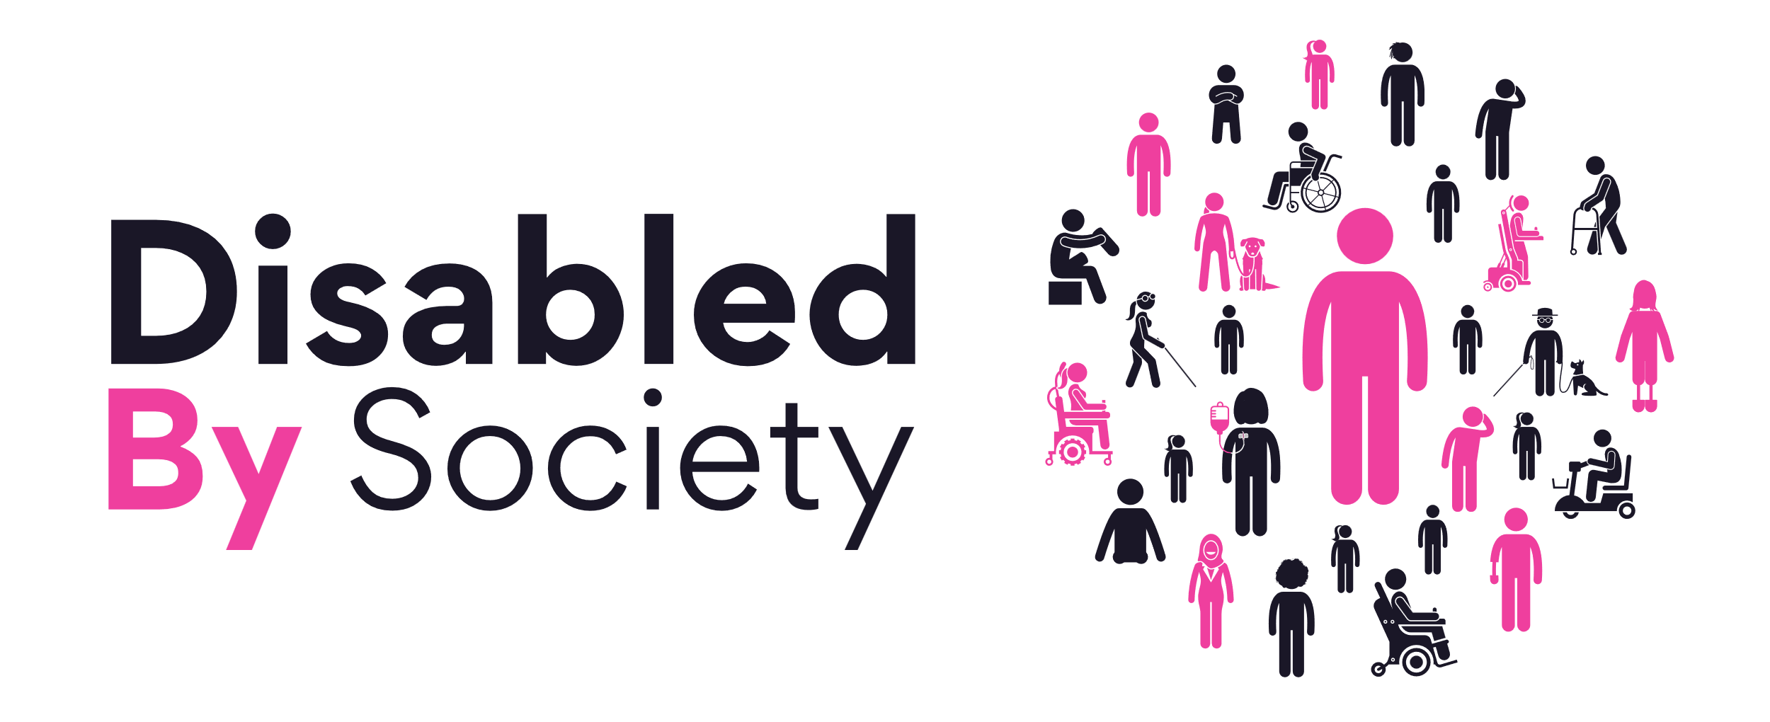
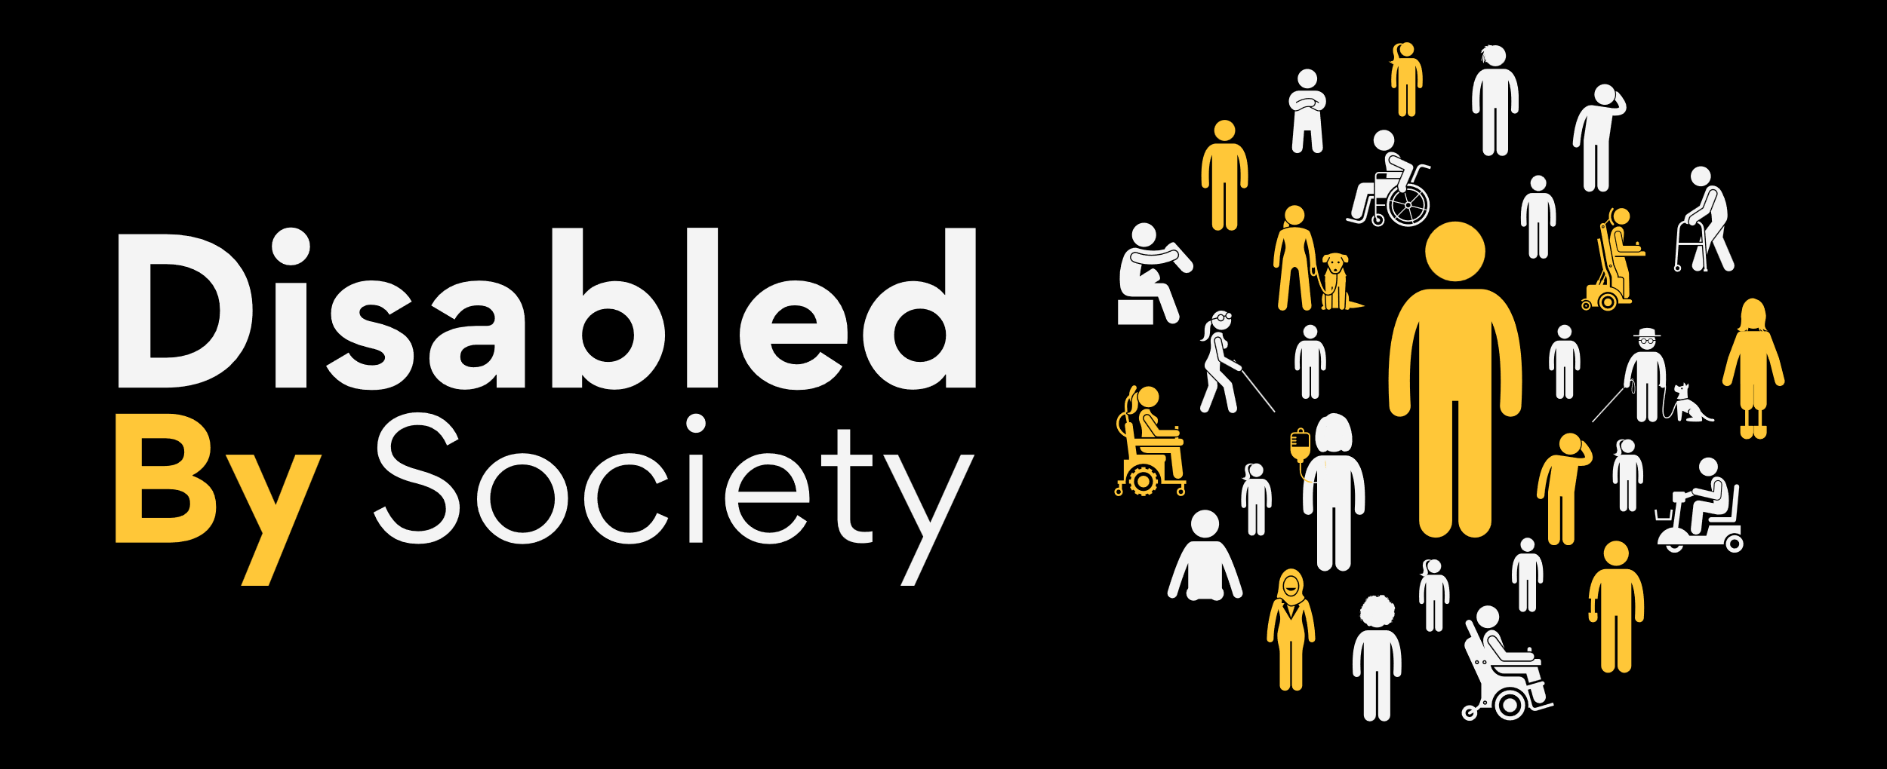
The Internalised Ableism Survey
Disabled By society are conducting a study into ‘Internalised Ableism’. Our 2024 ‘Big Ableism Survey’ discovered that only 6.6% Of Disabled people have never experienced mental health challenges as a direct result of their Disability, and only 1.5% of Disabled people have never experienced internalised ableism, only 30.6% have been taught about internalised ableism, and 50.3% of Disabled people experience internalised ableism every week.
The purpose of this study is to gather further qualitative and quantitative data and testimonials on individual and community experience of internalised ableism, digging deeper into these initial findings to guide wider research, and share our findings with our community. The aim of this research is to ultimately improve awareness, educational resources and understanding of internalised ableism to contribute to the removal of barriers of prejudice. The conclusions of this research will provide tangible demonstration of the Disabled experience and provide the practical tools on how all of us can do and be better.
By using the word Disabled we are recognising any person with a 'long term physical, mental, or neurodivergent condition/s which has a substantial and long term impact on their daily life' in line with United Nations definition. At Disabled By Society we uphold the upmost respect for an individuals right to self-identify, and recognise that not everyone uses the word 'Disabled' to describe themselves, with this survey still being applicable to them and their experiences with their condition.
All responses to this survey are anonymous and none of your personal details are shared with us, creating a safe space for you to share your views. Disabled By Society operate under total neutrality policy and none of the answers collated will be influenced by leanings or preferences.
Trigger warning: some of the questions featured in this survey may be triggering or cause distress, please feel free to exit this survey at any time and your answers will not be saved. None of these questions are compulsory, so please feel free to skip any of the questions you would prefer not to answer.
By contributing to this survey you are giving permission for your anonymous answers to be used. Details of our privacy policy and GDPR statement can be found: www.disabledbysociety.com/privacy/
If you would like this survey in an alternative format please email enquiries@disabledbysociety.com
Image description: The image shows a landscape rectangular banner with an off-black background. Across the centre in bold white and blue text it reads ‘The Internalised Ableism Survey’ and underneath in yellow, pink, blue and white text ‘Exclusion to Inclusion, Transforming Disability Inequities. On the left hand side is the logo for Disabled By Society, and on the right hand side an image of Celia and Jamie holding their hands up to their mouth and gasping with a shocked look on their faces. The banner is surrounded by a pink, yellow and blue black border on the top and bottom.

Slide 29
Questions from Survey
Q: Internalised Ableism is when a Disabled person discriminates against themself and/or other Disabled people by holding the view that Disability is something to be ashamed of, something to hide, or by refusing accessibility or support. Did you know the definition of internalised ableism before reading this statement?
Yes, No, Not Sure.
Q: How soon after your diagnosis/beginning of your journey identifying as Disabled did you learn about internalised ableism?
Less than a year, between 1 and 5 years, between 5 and 10 years, over 10 years.
Q: Where/who taught you about internalised ableism?
Someone from the Disabled community or another Disabled person, a parent/carer/guardian, social media, a medical/healthcare professional, an organisation/company/charity, other.
Q: Do you think enough is being done to educate about and address internalised ableism in schools/universities/educational bodies?
Yes, No, Not Sure.
Q: Do you think enough is being done to educate about and address internalised ableism in workplaces/employment?
Yes, No, Not Sure.
Q: Do you think enough is being done to educate about and address internalised ableism by medical professionals/healthcare providers?
Yes, No, Not Sure.
Q: Early intervention to break down internalised ableism cycles as soon as possible, access to information, and support is vital in tackling internalised ableism. Do you agree with this statement?
Yes, No, Not Sure.
Q: TW: In what ways has your internalised ableism manifested (check all that apply)
Mental health condition (eg: depression/anxiety/agoraphobia), addiction, suicidal or harmful thoughts, anger/frustration at myself or others, self-worth, unable or feeling like I can’t self-advocate, lateral ableism (ableism towards other Disabled people), isolation/loneliness, shame, hopelessness.
Q: Have you experienced internalised ableism whilst also simultaneously experienced other forms of internalised oppression (for example; racism, transphobia, sexism, classism, homophobia etc...)
Yes, No, Not Sure.
Q: Is there anything else you would like to tell us about how your internalised ableism makes you feel?
Q: Do you think there is enough awareness around internalised ableism in wider society?
Yes, No, Not Sure.
Q: Do you think there is enough access to professional support for internalised ableism, which is accessible, and where internalised ableism is correctly understood, and Disabled people are given the correct tools to support themselves?
Yes, No, Not Sure.
Q: Have you ever received professional support for internalised ableism?
Yes, No.
Q: If you answered yes to this previous question, did you find this support beneficial?
Yes, No, Not Sure.
Q: Is there anything else you would like to tell us?

Slide 30
Internalised Ableism Policy Paper
Data & Results
From Disabled By Society - Disability Pride 2025

